Slide 1
What is Linux?
known as GNU/Linux, is a free, UNIX-like operating system, developed originally for home PCs, but which now runs on practically every hardware platform available including PowerPC, Macintosh, DEC Alpha, Sun Sparc, ARM, Mainframes, and many others
POSIX compliancy to maintain maximum compatibility with other UNIX-like systems
The Linux System
The central nervous system of Linux is the kernel.
The kernel is under constant development.
The kernel design is modular, so that the actual OS code is very small yet able to load whatever functionality it needs when it needs it. Because of this, the kernel remains small and fast yet highly extensible, in comparison to other operating systems which slow down the computer and waste memory by loading everything all the time, whether it is needed or not.

Slide 2
Characteristics:
Stability:-
Linux has long been praised for its stability--Linux boxes are known for running months or even years at a time without crashing, freezing, or having to be rebooted
Linux is extremely secure compared to other platforms. Viruses and Trojan Horse programs are practically non-existent.
Speed:-
There are no arbitrary limits to the number of user accounts you can create, the number of simultaneous connections your Linux-based web server can handle, or arbitrary limits any other Linux resources.
Linux machines are known to be extremely fast, because the operating system is very efficient at managing resources such as memory, CPU power, and disk space.

Slide 3
Graphical Interface
Xorg, a free implementation of the X Window System. The most popular complete desktop environments at present are KDE (the K Desktop Environment) and GNOME (the GNU Network Object Model Environment).
Software Development
Nearly all development software for Linux is free and covered under the GNU Public License, which guarantees that it will always remain free. Linux systems come standard with C and C++ compilers and an assembler, and usually include Pascal, FORTRAN, compiled Java, Perl, Python, and BASIC implementations as well.
Eclipse and KDevelop -two development tools support web application development
The source code for nearly any Linux program is freely available
The Open Source nature of Linux also makes it ideal for embedded and specialized systems (routers, cell phones, multimedia entertainment centers, point-of-sale systems), because there's no limit to what you can do to customize Linux for your special needs.

Slide 4
Networking
All networking protocols in use on the Internet are native to UNIX and/or Linux, so one can expect that UNIX and Linux would network better than any other platforms. Setting up a network on a Linux machine is surprisingly simple, because Linux handles most of the work.
Productivity
Software availability and commercial developers have been producing excellent software for the Linux platform. The Firefox browser, Opera, and Mozilla, the OpenOffice productivity suite, KOffice and a host of others, which often come standard on Linux distributions.
You can run many Windows programs on Linux via Wine, or commercial helper products such as Crossover Office or Cedega, both of which even support the popular game Word of Warcraft!
Linux distributions from a CD or DVD, without the need to install the operating system, allows users to see if they like Linux without erasing their old OS or having to buy another computer.

Slide 5
Longevity
The open source nature of Linux guarantees growth as it can never get locked depending on any particular vendor

Slide 6
Processes
A process is a program in execution; process execution must progress in sequential fashion. Can be characterized by its trace.
A process requires resources, which are managed by the operating system
The OS interleaves the execution of several processes to maximize processor utilization
OS supports InterProcess Communication (IPC) and user creation of processes

Slide 7
Simple Two-State Model
Schedule
Enter
Not
Running
Running
Exit
Pause
(a) State transition diagram

Slide 8

Queuing Diagram
Queue
Schedule
Enter
Processor
Exit
Pause
(a) Queuing diagram
Scheduler
  Program that assigns the processor to one process or another
  Prevents a single process from monopolizing processor time

Slide 9
5 Process States
As a process executes, it changes state
  New: The process is being created.
  Running: Instructions are being executed.
  Waiting or blocked: The process is waiting for some event to occur (e.g.
  Ready: The process is waiting to be assigned to a process.
  Terminate or Exit: The process has finished execution.

Slide 10

Diagram of Process State

Slide 11
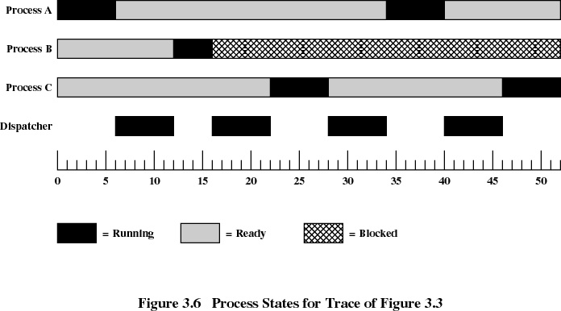
Example for 3 Processes

Slide 12
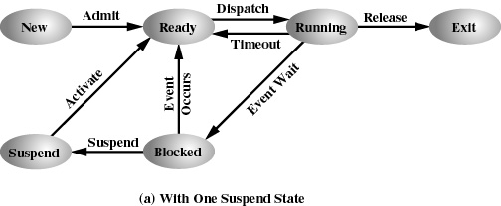
Suspending Processes

Slide 13
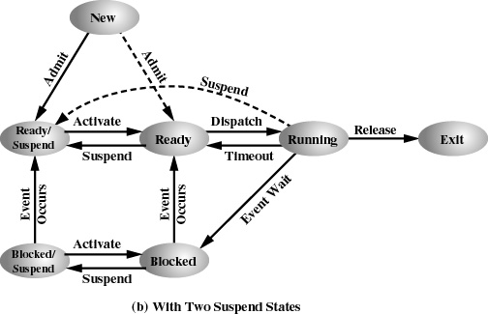
Two Suspended States

Slide 14
OS Control Structures
Memory Tables
Process Image
Memory
I/O Tables
User data
User program
System stack
PCB
I/O
File
File Tables
Processes
Primary Table
Process 1
Process 2
…
Process N

Slide 15
Process Control Block (PCB)
Information associated with each process.
  Process state
  Program counter
  CPU registers
  CPU scheduling information
  Memory-management information
  Accounting information
  I/O status information

Slide 16
Process Scheduling Queues
Job queue – set of all processes in the system.
Ready queue – set of all processes residing in main memory, ready and waiting to execute.
Device queues – set of processes waiting for an I/O device.
Process migration between the various queues.

Slide 17

Process Scheduling

Slide 18
Process Creation
Parents create children; results in a tree of processes.
Resource sharing
  Parent and children share all resources.
  Children share subset of parent’s resources.
  Parent and child share no resources.
Execution
  Parent and children execute concurrently.
  Parent waits until children terminate.

Slide 19
A Traditional LINUX Kernel
execution environment
application
trap
libraries
user
System call interface
kernel
System Services
File subsystem
dispatcher
IPC
Process
control
subsystem
Buffer cache
Scheduler
Exceptions
Interrupt
char
block
Memory
Device drivers
hardware

Slide 20
Basic Concepts and Terminology
Two privilege levels
  user and system mode
  kernel space protected: requires special instruction sequence to change from user to kernel mode
Process has "protected" address space
all process share same kernel space
per process state (u_area) in kernel
per process kernel stack
  kernel is re-entrant
system versus process context

Slide 21
Mode, Space and Context
Privileged
mode
user
kernel
context
process
Application
(user code)
System calls
Exceptions
system
space
kernel
X
not allowed
Interrupts,
System tasks

Slide 22
The LINUX Kernel
loaded at boot time and initializes system,
  creates initial system processes.
  remains in memory and manages the system
Resource manager/mediator -
  process is key abstraction
  Time share (time-slice) the CPU,
  coordinate access to peripherals,
  manage virtual memory.
  Performs privileged operations.
provides synchronization primitives.
Well defined entry points
  syscall, exceptions or interrupts.

Slide 23
Shell Scripts
(1) Use any editor like vi to write shell script.
(2) After writing shell script set execute permission for your script as follows
syntax:
chmod permission your-script-name
Examples:
$ chmod +x your-script-name
$ chmod 755 your-script-name
Note: This will set read write execute(7) permission for owner, for group and other permission is read and execute only(5)
(3) Execute your script as
syntax:
bash your-script-name
$sh your-script-name
$./your-script-name
(5)exit status for a shell script
(a) If return value is zero (0), command is successful.
(b) If return value is nonzero, command is not successful or some sort of error executing command/shell script.
To check
try to remove a non existing file using
rm <filename>
echo $?
1
give a successfule shell command
ls
echo$?
0

Slide 24
vi firstscript
clear
echo "Hello $USER"
echo "Today is \c ";date
echo "Number of user login : \c" ; who | wc -l
echo "Calendar"
cal
exit 0
Remark:
To run two command with one command line….use “;”
Examples:
$ date;who

Slide 25
Variables in Shell
In Linux (Shell), there are two types of variable:
(1) System variables - Created and maintained by Linux itself. This type of variable defined in CAPITAL LETTERS.
(2) User defined variables (UDV) - Created and maintained by user. This type of variable defined in lower letters.

Slide 26
Rules
(1) Variable name must begin with Alphanumeric character or underscore character (_), followed by one or more Alphanumeric character.
(2) Don't put spaces on either side of the equal sign when assigning value to variable.
(3) Variables are case-sensitive, just like filename in Linux
(4) You can define NULL variable as follows (NULL variable is variable which has no value at the time of definition) For e.g.
$ vech=
$ vech="“
(5) Do not use ?,* etc, to name your variable names.

Slide 27
User Defined Variable(UDV)
To define UDV use following syntax
Syntax:
variable name=value
eg: vech=Bus
n=10
To print or access UDV use following syntax
Syntax:
$echo $variablename
Point out error if any in following script
$ vi testscript
myname=Prajose
myos = TroubleOS
myno=5
echo "My name is $myname"
echo "My os is $myos"
echo "My number is myno, can you see this number"

Slide 28
Shell Arithmetic
Syntax:
expr op1 math-operator op2
eg.:
Examples:
$ expr 1 + 3
$ expr 2 - 1
$ expr 10 / 2
$ expr 20 % 3
$ expr 10 \* 3
$ echo `expr 6 + 3`
Remark: * is wild character and so negated
` is backquote for command execution

Slide 29
read and if Statement
To get input (data from user) from keyboard and store (data) to variable.
Syntax:
read variable1, variable2,...variableN
eg.:
echo "Your first name please:"
read fname
echo "Hello $fname, Lets meet at eI"
if condition
if condition is used for decision making in shell script,
If given condition is true then command1 is executed.
Syntax:
if condition
then command1 if condition is true or if exit status of condition is 0 (zero) ... ...
fi
Condition is defined as:
"Condition is nothing but comparison between two values."
For comparision you can use test or [ expr ] statements or even exit status can be also used.
if cat $1
then
echo -e "\n\nFile $1, found and successfully echoed“
fi

Slide 30
Numeric comparisions
test or [ expr ] works with
1.Integer ( Number without decimal point)
2.File types
3.Character strings
if test $1 -gt 0
then
echo "$1 number is positive"
fi
other operators:
-eq if test x –eq 3 or if [x –eq 3]
-ne
-lt
-gt
-ge

Slide 31
String comparisions
string1 = string2 => string1 is equal to string2
string1 != string2 => string1 is not equal to string2
string1 => string1 is NOT NULL or not defined
-n string1 => string1 is NOT NULL and does exist
-z string1 => string1 is NULL and does exist
File comparisions
-s file Non empty file
-f file Is File exist or normal file and not a directory
-d dir Is Directory exist and not a file
-w file Is writeable file
-r file Is read-only file
-x file Is file is executable
Logical Operators
! expression Logical NOT
expression1 -a expression2 Logical AND
expression1 -o expression2 Logical OR

Slide 32
Bash supports: for loop while loop
for { variable name } in { list }
do
execute one for each item in the list
until the list is not finished (And repeat all statement between do and done)
done
eg.:
if [ $# -eq 0 ]
then
echo "Error - Number missing form command line argument"
echo "Syntax : $0 number"
echo "Use to print multiplication table for given number"
exit 1
fi
n=$1
for i in 1 2 3 4 5 6 7 8 9 10
do
echo "$n * $i = `expr $i \* $n`"
done
$./<filename> 5

Slide 33
while loop
Syntax:
while [ condition ]
do
command1 command2 command3 .. ....
done
if [ $# -eq 0 ]
then
echo "Error - Number missing form command line argument"
echo "Syntax : $0 number"
echo " Use to print multiplication table for given number"
exit 1
fi
n=$1
i=1
while [ $i -le 10 ]
do
echo "$n * $i = `expr $i \* $n`"
i=`expr $i + 1`
done

Slide 34
CASE Statement
case $variable-name in
pattern1) command ... .. command;;
pattern2) command ... .. command;;
patternN) command ... .. command;;
*) command ... .. command;;
esac
eg.:
if [ -z $1 ]
then
rental="*** Unknown vehicle ***"
elif [ -n $1 ]
then
# otherwise make first arg as rental
rental=$1
fi
case $rental in
"car") echo "For $rental Rs.20 per k/m";;
"van") echo "For $rental Rs.10 per k/m";;
"jeep") echo "For $rental Rs.5 per k/m";;
"bicycle") echo "For $rental 20 paisa per k/m";;
*) echo "Sorry, I can not gat a $rental for you";;
esac

Slide 35
Exercise
Write script to print given numbers sum of all digit, For eg. If no is 123 it's sum of all digit will be 1+2+3 = 6.
Write script to determine whether given file exist or not, file name is supplied as command line argument, also check for sufficient number of command line argument.
Write script to implement getopts statement, your script should understand following command line argument called this script myscript,
myscript -c -d -v
Where options work as
-c clear the screen
-d show list of files in current working directory
-v starts the vi editor

Slide 36
How to de-bug the shell script?
To find the errors (bugs) in shell script and correct the errors
Syntax:
sh –x <filename>
Global variable
Eg.:
v=prajose
echo $v
/bin/bash #initiates another shell
echo $v
???? #here output is null
exit
echo $v
Solution: use export command

Slide 37
Conditional execution (&& and ||)
The control operators are && (read as AND) and || (read as OR).
Syntax:
command1 && command2
command2 is executed if, and only if, command1 returns an exit status of zero.
The syntax for OR list as follows
Syntax:
command1 || command2
command2 is executed if and only if command1 returns a non-zero exit status.
both can be used as follows
Syntax:
command1 && comamnd2 if exit status is zero || command3 if exit status is non-zero
if command1 is executed successfully then shell will run command2 and if command1 is not successful then command3 is executed.
Example:
$ rm myf && echo "File is removed successfully" || echo "File is not removed"
If file (myf) is removed successful (exist status is zero) then "echo File is removed successfully" statement is executed, otherwise "echo File is not removed" statement is executed (since exist status is non-zero)

Slide 38
getopts command
This command is used to check valid command line argument are passed to script. Usually used in while loop.
Syntax:
getopts {optsring} {variable1}
getopts is used by shell to parse command line argument.
"optstring contains the option letters to be recognized; if a letter is followed by a colon, the option is expected to have an argument, which should be separated from it by white space.
Each time it is invoked, getopts places the next option in the shell variable variable1,
When an option requires an argument, getopts places that argument into the variable OPTARG. On errors getopts diagnostic messages are printed when illegal options or missing option arguments are encountered. If an illegal option is seen, getopts places ? into variable1."
while getopts n:a:s:w:d opt
do
case "$opt" in
n) na="$OPTARG";;
a) age="$OPTARG";;
s) sex="$OPTARG";;
w) weight="$OPTARG";;
d) isdef=1;;
\?) help_ani;;
esac
done
$shellfile -n Lassie -a 4 -s Female -w 20Kg

Slide 39
Functions:
Saves lot of time.
Avoids rewriting of same code again and again
Program is easier to write.
Program maintainance is very easy.
To define function use following syntax:
Syntax:
function-name ( )
{
command1
command2
..... ...
commandN
return # will terminate the function
}
To execute this function just type its name.

Slide 40
cls()
{
clear
echo "Clear screen, press a key . . ."
read
return
}
## Function to show files in current directory #
show_ls()
{
ls
echo "list files, press a key . . ."
read
return
}
while getopts c:d opt
do
case "$opt" in
c) cls;;
d) show_ls;;
exit 1;;
Esac
done

Slide 41
To know ip information:
$ifup eth0
Available in
/etc/sysconfig/network-scripts/ifconfig-eth0
To set ip and networking
#neat
To connect to remote desktop
$rdesktop <ipaddress>
To detect and configure new h/w
$kudzu –p
Steps to mount d-drive in windows from linux
# mkdir /mnt/<mountpointdir>
# fdisk –l #check the partition for d-drive
# mount /dev/had<no> /mnt/<mountpointdir>
# cd /mnt/<mountpointdir>
To access window CD-drive on windows m/c from linux desktop
# mount –t smbfs –o username=<username>,password=<password> //<ipaddress>/<drive-name>/mnt/<dir>
Show file to setup samba server

Slide 42
Write shell script to show various system configuration like
1) Currently logged user and his logname
2) Your current shell
3) Your home directory
4) Your operating system type
5) Your current path setting
6) Your current working directory
7) Show Currently logged number of users
8) About your os and version ,release number , kernel version
9) Show all available shells
10) Show mouse settings
11) Show computer cpu information like processor type, speed etc
12) Show memory information
13) Show hard disk information like size of hard-disk, cache memory, model etc
14) File system (Mounted)

